Slide 1

Front-end Application
Partner Network
MS SQL
Server
T0 – T1
PO data
partner network
T1 – T2
DataMyne Crawler
CAPIQ – Credit Health
Page Crawler
Temporal Exposure
Open Weather API
CSI Market
Financial Crawler
Temporal Risk scoring engine
Structural
Exposure
Structural Risk scoring engine
The dark blue boxes indicate the backend modules which will be developed using pyspark

Slide 2
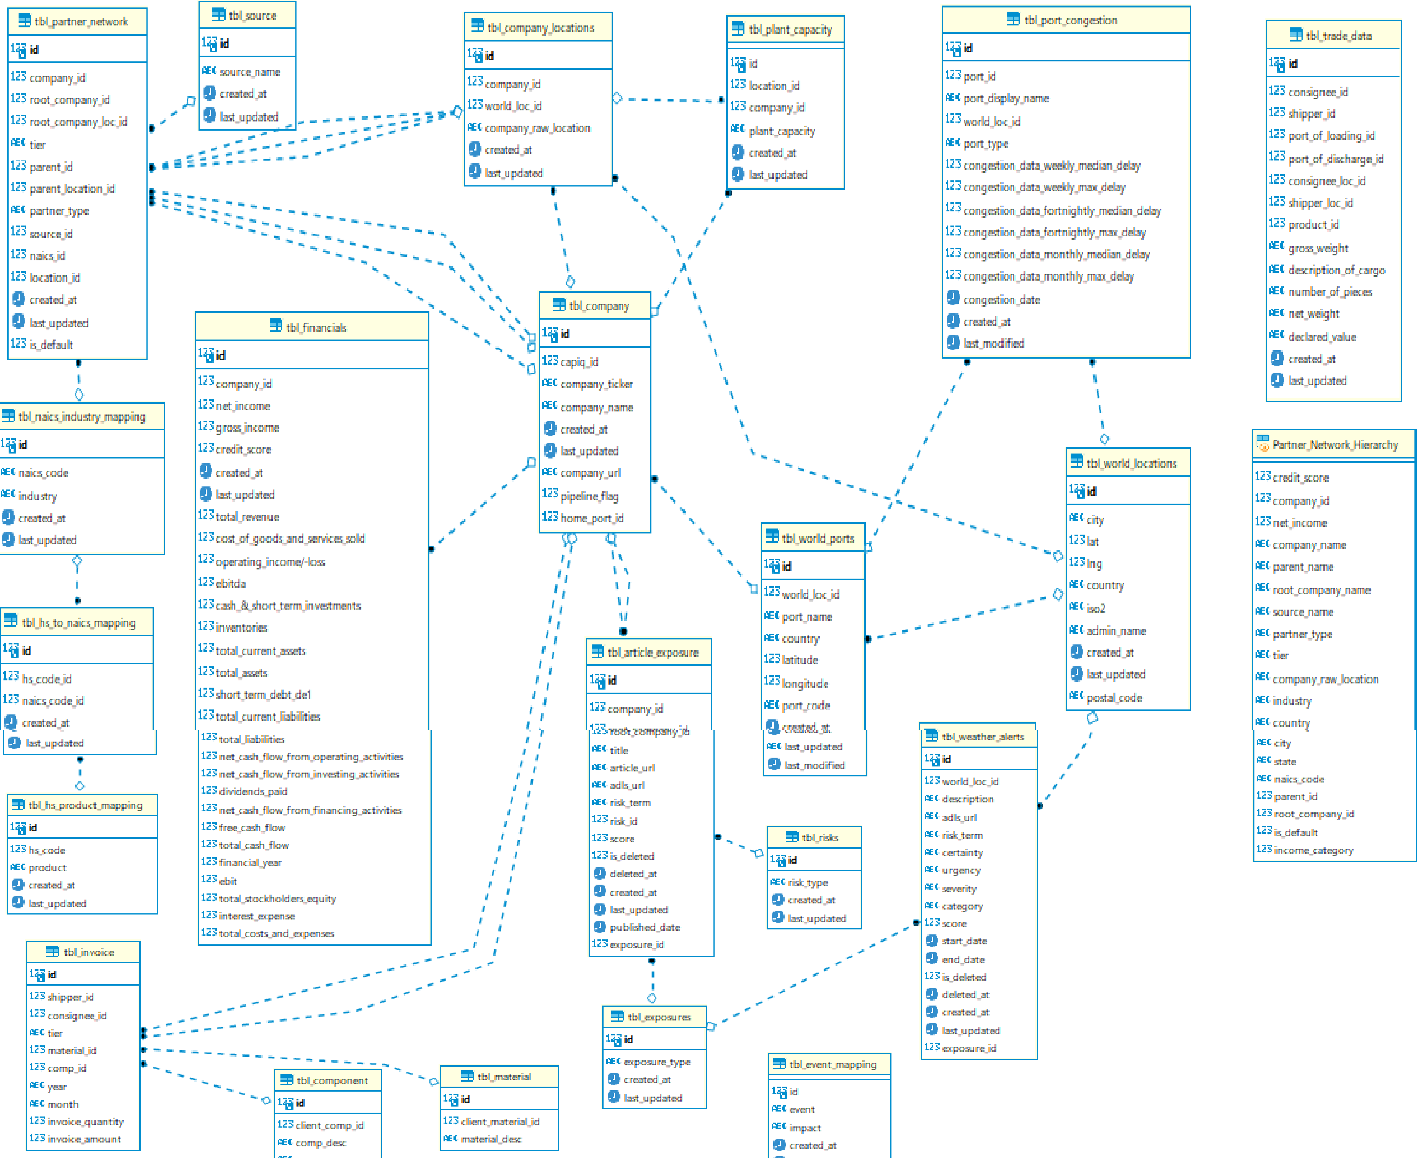

Slide 3
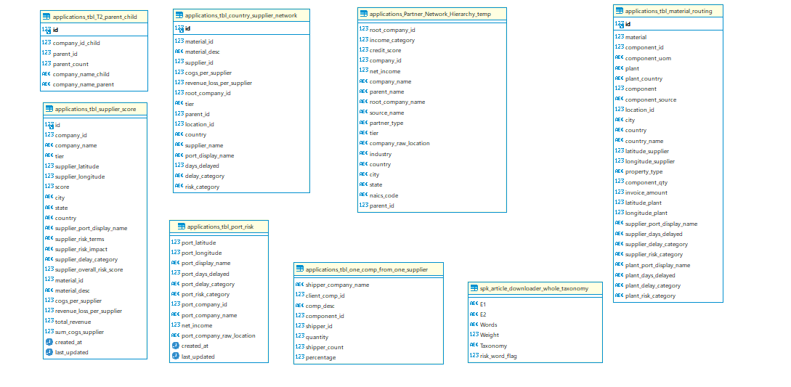

Slide 4
DataMyne partner network
Company listing
Iterating over company names
Searching companies through API
Requesting page for current company
Partner Network
Page Exists
Yes
Store Dataframe into the database
No
Got to next company
Scrape the Dataframe of the result

Slide 5
PO data partner network
PO data
Reading data from ADLS
Processing Data
Creating partner
Store Dataframe in the database
Partner Network
T0 – T1

Slide 6
GO Comet
Partner Network
GO Comet API
Authentication
Correct credential
No
Yes
Port congestion database
Scarpe data for port congestion
Mapping it to company location
Save to database

Slide 7
Partner Network
Iterating over company names
Set base URL for CSIMarket
Requesting page for current company
Page Exists
Yes
Store Dataframe into the database
Financial database
No
Got to next company
Scrape the financial Dataframe of the result
Csi market financial

